Slide 1

Incident Analysis Insights
Data-driven Dashboard Presentation
-MansI

Slide 2
Introduction
Purpose of Incident Analysis:
Understanding and analysing incidents within an organization is crucial for proactive management.
Incident analysis allows us to delve into the details of events, identify patterns, and derive valuable insights. By comprehensively examining incidents, aim is to enhance decision-making processes, improve response strategies, and ultimately contribute to a more resilient and efficient operational environment.
Goal of the Presentation:
The goal of this presentation is to present key findings and insights derived from our incident analysis. Through visualizations and data-driven narratives, aim to convey actionable information that can guide strategic decisions, optimize incident response, and bolster overall organizational resilience. Our focus is on translating complex data into meaningful takeaways that empower stakeholders to make informed choices and improve our incident management processes.

Slide 3
Dataset Overview
Dataset Brief:
Time Range Covered:
- The dataset encompasses incidents reported within the Month range JUNE to AUGUST.
Types of Incidents Included:
- The dataset captures a variety of incident types spanning different severity levels, services, assignment groups, products and departments.
Key Dataset Columns:
- Number(Incidents), Month, Site, Opened, Assigned to, Assignment group, Owner group, Status, Opened by, Severity, Service, Contact type, Service Offering, Type, Category, Configuration item, Created, Resolved, Closed, Caller Department, Short description, Description, Translation, KB Article Used, Caller Notes, Region, Reassignment count, Product, Issues.

Slide 4
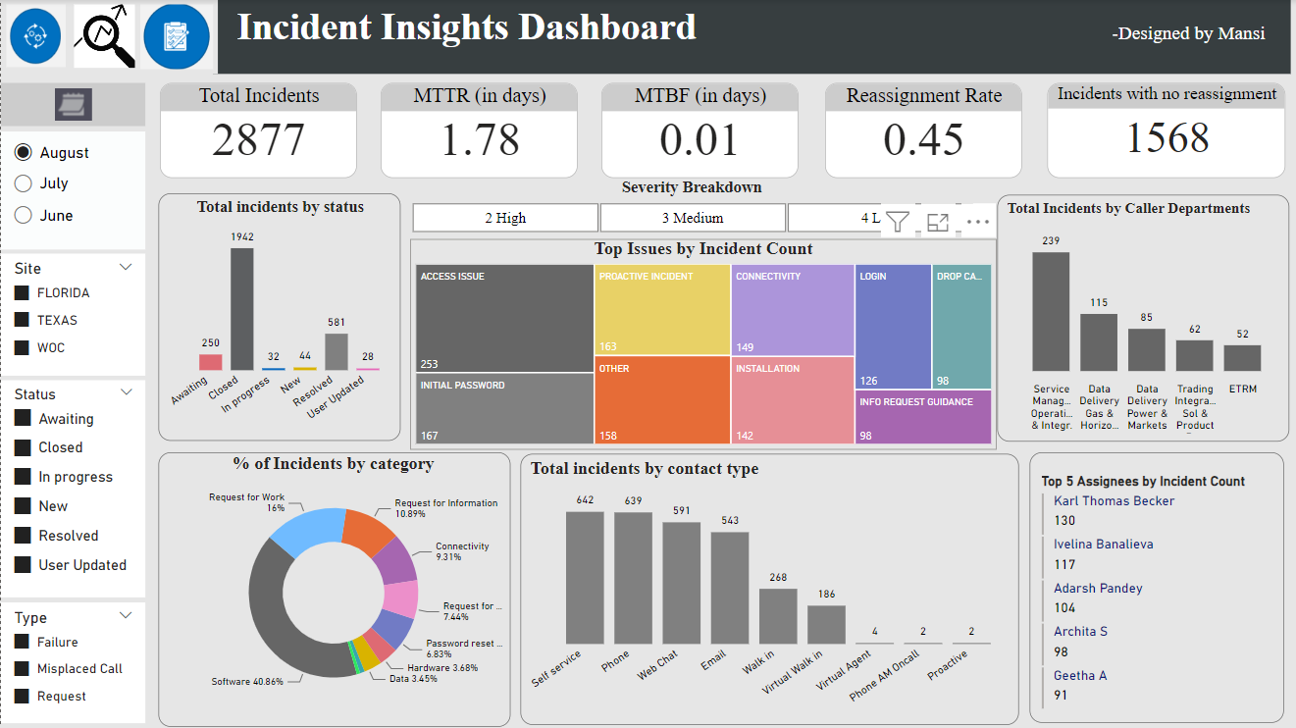
Dashboard Snapshot: (August Month)

Slide 5
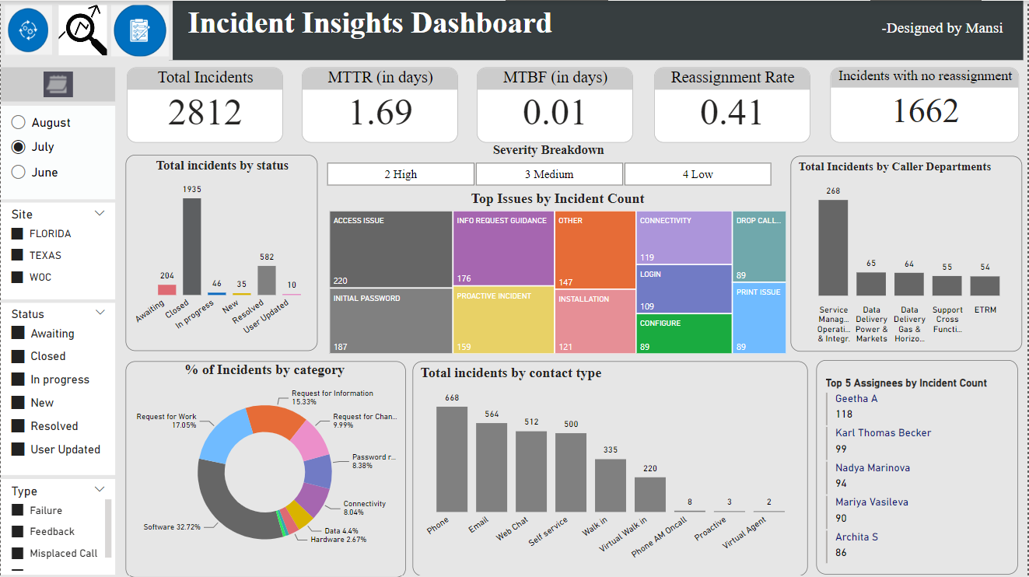
Dashboard Snapshot: (July Month)

Slide 6
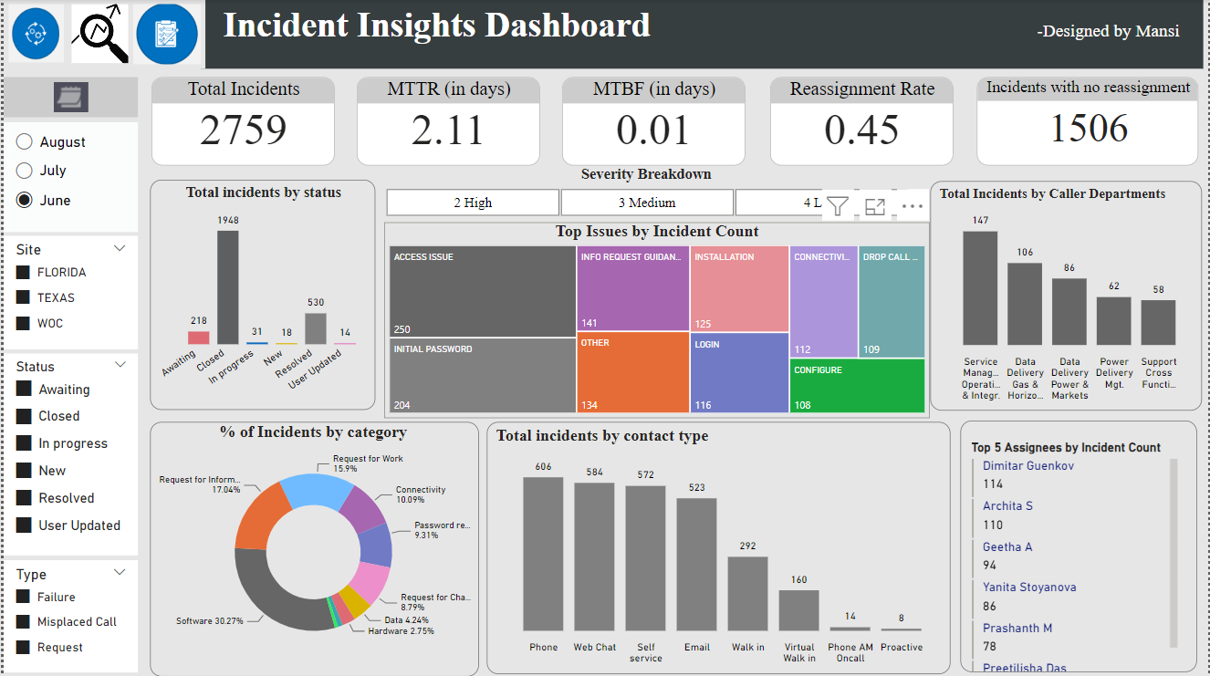
Dashboard Snapshot: (June Month)

Slide 7

Slicers Overview: The incident analysis dashboard incorporates dynamic slicers to empower users in customizing their data exploration. Slicers provide an interactive experience, enabling a tailored approach to incident analysis.
Month Slicer:
Enables users to filter incidents based on the specific month.
Facilitates trend analysis and comparisons across different time periods.
Site Slicer:
Allows users to focus on incidents specific to a particular site or location.
Tailors the analysis to the context of individual sites, aiding in localized problem-solving.
Status Slicer:
Filters incidents based on their current status (e.g., open, closed, in-progress).
Provides a quick overview of the current state of incidents
Type Slicer:
Filters incidents by their specific type or category (e.g., misplaced call, failure, request).
Segments incidents based on their specific types, aiding in targeted analysis.
This Severity slicer will distribute the incidents into Priority level: HIGH,MEDIUM,LOW

Slide 8
Key Metrics Overview:
(August)
(July)
(June)
1. Total Incidents:
Definition: The total number of reported incidents during the specified time period.
Insight: This metric provides an overall view of incident frequency, helping us understand the volume of events that occurred.
2. MTTR (Mean Time to Resolve):
Definition: The average time taken to resolve incidents from the moment they are reported.
Insight: MTTR indicates the efficiency of our incident resolution process. A lower MTTR suggests quicker issue resolution and improved service levels.
3. MTBF (Mean Time Between Failures):
Definition: The average time elapsed between consecutive incidents.
Insight: MTBF helps assess the reliability of our systems or processes. A higher MTBF suggests a more stable operational environment.
4. Reassignment Rate:
Definition: The percentage of incidents that were reassigned to another team or individual.
Insight: This metric reveals how often incidents are redirected to different teams, indicating potential challenges in initial assignment or communication gaps.
5. Incidents with No Assignment:
Definition: Incidents with no reassignment refer to cases where the initial assignee or assignment group successfully handles and resolves the incident without the need for it to be reassigned to another individual or team.
Insight: The absence of reassignments suggests that the incident was successfully addressed by the initial responder or team, minimizing the need for additional involvement..

Slide 9
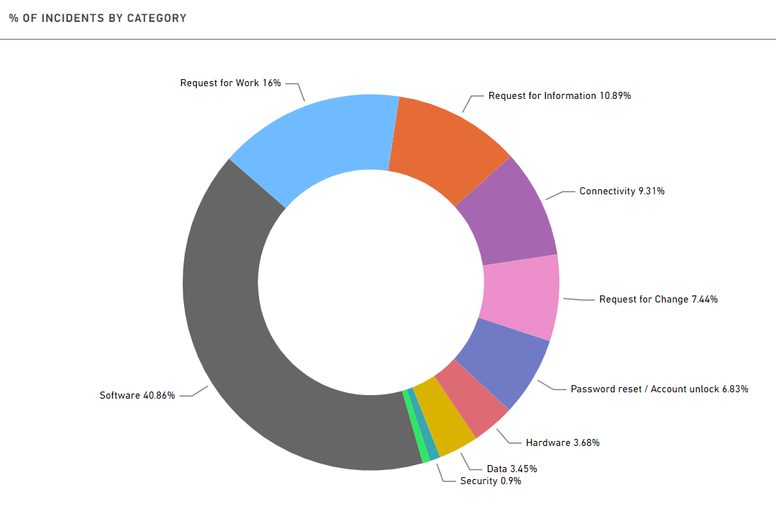
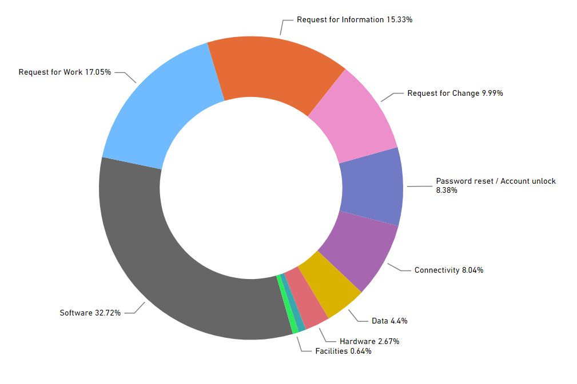
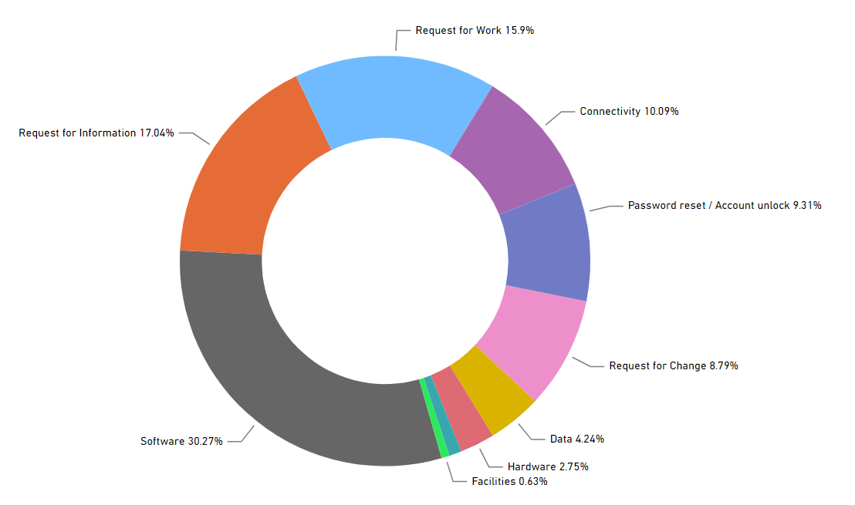
August
July
% OF INCIDENTS BY CATEGORY
We can identify the dominant incident categories to focus on areas that require immediate attention.
We can use this information to prioritize resources and efforts for proactive incident management.
June

Slide 10
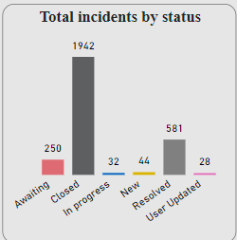
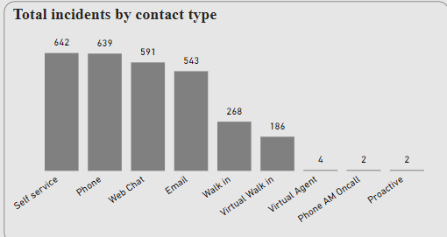
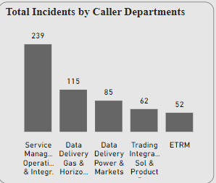
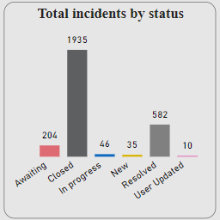
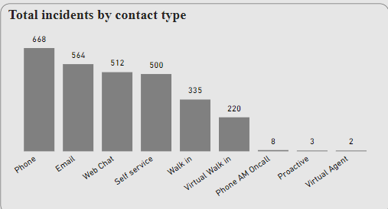
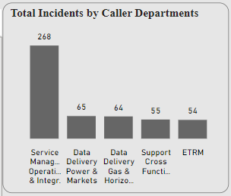
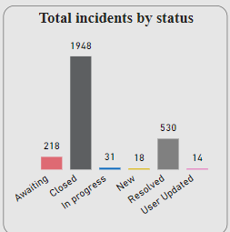
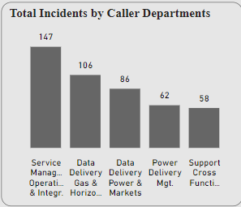
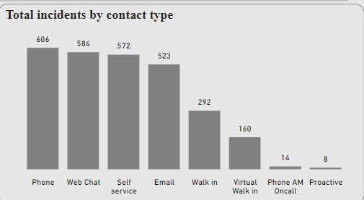
Top 5
August
July
June
Comparative Analysis of three months data for total incidents by Status, Top 5 Caller Departments having maximum incidents, total incidents by contact type
Notes:
Actionable Takeaways:
Identify trends in incident status to improve response times and resolution efficiency.
Allocate resources strategically based on caller departments with the highest incident counts.
Tailor communication strategies based on the prevalent contact types for effective incident reporting.

Slide 11
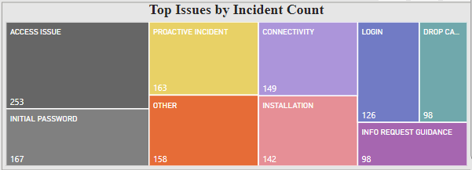
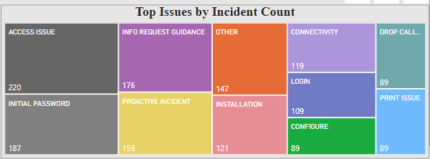
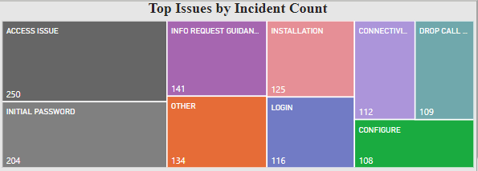
August
July
June
Analysing the top issues based on incident count is essential for prioritizing problem resolution efforts and understanding the most common challenges faced.
Actionable Takeaways:
- Prioritize resources and solutions for the identified top issues to improve overall incident resolution efficiency.
- Addressing these top issues proactively can lead to a more stable operational environment.

Slide 12
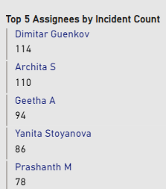
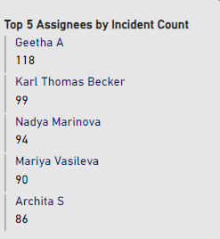
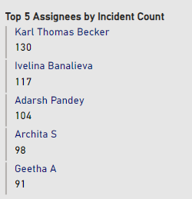
June
July
August
Identifying the top assignees based on incident count sheds light on the key contributors to incident resolution.
This slide highlights the technicians or teams who handle a significant number of incidents, providing insights into workload distribution.
Actionable Takeaways:
- Acknowledge and appreciate the efforts of the top assignees who contribute significantly to incident resolution.
- Consider workload distribution and ensure equitable resource allocation for a balanced team performance.

Slide 13
Recommendations & Conclusion
1. Addressing Unresolved Incidents:
- Recommendation: Conduct a thorough analysis of the unresolved incidents to identify root causes and implement corrective measures. Consider implementing additional training or resources to address persistent challenges.
- Actionable Steps: Initiate a team to investigate open incidents, categorize the reasons for delays, and implement targeted solutions.
2. Proactive Issue Resolution:
- Recommendation: Given the low MTTR, continue the focus on proactive issue resolution to maintain efficient incident management.
- Actionable Steps: Enhance communication channels, ensure prompt issue identification, and streamline resolution processes for continuous improvement.
3. Exploring Causes of Incident Increase:
- Recommendation: Investigate the significant increase in incident creation, especially in August, to understand underlying factors and prevent future escalations.
- Actionable Steps: Collaborate with relevant departments to identify patterns, conduct trend analysis, and implement preventive measures to mitigate a surge in incidents.
4. Enhancing Incident Response Strategy:
- Recommendation: Despite a low reassignment rate, explore ways to optimize incident assignment processes for even greater efficiency.
- Actionable Steps: Evaluate the current incident assignment workflow, seek feedback from assignees, and implement improvements to minimize reassignments.
SLA Consideration: Review and refine SLAs to ensure they align with the timeframes identified during the analysis. Communicate any necessary adjustments to stakeholders. Ensure that SLAs accurately reflect the optimized incident assignment process, and adjust as needed to align with enhanced efficiency..
Conclusion:
In conclusion, the incident analysis dashboard has provided valuable insights into our operational landscape. While our incident management demonstrates efficiency in resolving issues promptly (low MTTR and high MTBF), there are areas for improvement, such as addressing unresolved incidents and exploring the causes of the recent surge in incidents. The identification of top issues, common severities, and key assignees further guides us in strategizing for proactive incident resolution. SLA considerations are essential for aligning recommendations with performance expectations and ensuring a commitment to service quality.

Slide 14
Detailed Analysis using Key insights from Power BI dashboard:
1. Increasing Incident Creation:
- Insight: The total number of incidents has seen a significant rise, particularly in August (2877 incidents) compared to July and June, indicating a growing trend in reported issues.
For August, ‘failure’ incidents – 1680 , ‘request’ incidents – 1107.
- There are 4408 incidents out of total 8448 created due to ‘Failure’ in various categories which is a big chunk.
3774 incidents out of 8448 created as ‘request’.
2. Low Mean Time to Resolve (MTTR):
- Insight: The MTTR is impressively low at 1.78 days, suggesting efficient incident resolution.
For August, ‘failure’ incidents – 1680 having MTTR: 2.31.
‘request’ incidents – 1107 having MTTR: 1.20.
3. High Mean Time Between Failures (MTBF):
- Insight: The MTBF of 0.01 days indicates a relatively infrequent occurrence of incidents, highlighting a stable operational environment.
‘request incidents’ has little higher MTBF than ‘failure incidents’
4. Low Reassignment Rate:
- Insight: A reassignment rate of 0.45 suggests incidents are typically assigned correctly on the first attempt, minimizing the need for redirection. 45% incidents are reassigned in August. Also ‘failure incidents’ are reassigned more times than ‘request incidents’.
5. Unresolved Incidents:
- Insight: A substantial number of incidents (1942-581=1361) remain open, indicating a challenge in timely resolution. Those incidents for which the reported issue is considered closed without a full resolution. It includes cases where further action is unnecessary, such as when the reported issue was a duplicate, invalid, or no longer relevant.
6. Top Five Issues:
- Insight: Issues such as ACCESS ISSUE, PROACTIVE INCIDENT, CONNECTIVITY, LOGIN, INSTALLATION, INITIAL PASSWORD and DROP CA dominate, signifying the primary challenges faced.

Slide 15
The power BI file created for analysis and visualization
THANK YOU
********************

